Slide 1

Rahul Srivastava

Slide 2
What is AnGular 2
Angular 2 is built around the concept of components, and more precisely, with the Web Components standard in mind. It was rewritten from scratch by the Angular team using Typescript (although you can use it with ES5, ES6, or Dart as well). The digest cycle from Angular 1.X has been replaced by another internal mechanism known as “Change Detection”. This feature, along with other improvements and tweaks, yields a considerable increase in performance (up to 5 times faster, according to some official sources).

Slide 3
Motivations for Angular 2.0
So, you might be wondering: Why make Angular 2.0 at all? Why make such a big jump to 2.0 and why so many breaking changes? Is this all arbitrary? I can deal with a few changes, but from what I've been hearing, there are lots of big changes in 2.0. Are they really justified? Is it worth it?
I'd like to take a few moments to talk about some of the high level motivations for the changes that are coming in 2.0 before I dig into the details of features. I hope this will provide a foundation of understanding upon which those later details can sit and provide a basis for meaningful criticism (some of which I intend to offer up myself).

Slide 4
Performance
When AngularJS was first created, almost five years ago, it was not originally intended for developers.It was a tool targeted more at designers who needed to quickly build persistent HTML forms.
Over time it has changed to accommodate a variety of scenarios and developers have picked it up and used it to build more and more complex applications.
The Angular 1.x team has worked hard over the years to make incremental changes to the design, allowing it to continue to be relevant as the needs of modern web applications have changed.
However, there are hard limits on the improvements that can be made, due to assumptions that were made as part of the original design. A number of these limits relate to performance problems resulting from the current binding and templating infrastructure. In order to fix those problems, new strategies are needed.

Slide 5
Note ON Typescript
We’ll use Typescript for demonstrating the new aspects of Angular 2, mostly because that’s the way the official documentation is written, and you’ll get the most benefits getting to know Angular 2 this way. It’s also safe to assume that most of the tutorials and articles on Angular 2 will also feature Typescript.

Slide 6
The Changing Web
In the five years since Angular was first conceived, the web has changed significantly. For example, five years ago it was almost impossible to build a proper cross-browser site without help from something like jQuery. However, today's browsers are not only more consistent in their DOM implementations, but these implementations are faster and offer new features particularly pertinent to application frameworks.

Slide 7
ES 6 and beyond
While massive changes have happened in the last couple of years, they pale in comparison to what's coming in the next 1-3 years. In a few months the ES6 spec will be finalized. Today's browsers already support some of these features and are working on implementations of the rest right now. This means browser support for things like modules, classes, lambdas, generators, etc. These features fundamentally transform the JavaScript programming experience.

Slide 8
Web Components
These features fundamentally transform the JavaScript programming experience. But big changes aren't constrained merely to JavaScript. Web Components are on the horizon. The term Web Components usually refers to a collection of four related W3C specifications:
Custom Elements - Enables the extension of HTML through custom tags.
HTML Imports - Enables packaging of various resources (HTML, CSS, JS, etc.).
Template Element - Enables the inclusion of inert HTML in a document.
Shadow DOM - Enables encapsulation of DOM and CSS.
By combining these four capabilities web developers can create declarative components (Custom Elements) which are fully encapsulated (Shadow DOM). These components can describe their own views (Template Element) and can be easily packaged for distribution to other developers (HTML Imports). When these specifications become available in all major browsers, we are likely to see developer creativity explode as many endeavor to create reusable components to solve common problems or address deficiencies in the standard HTML toolkit

Slide 9
Mobile
Speaking of five years ago...me oh my how the computing landscape has changed! Phones and tablets are everywhere! While Angular can be used to build mobile apps, it wasn't designed with them in mind. This includes everything from the fundamental performance issues I've already mentioned to missing capabilities of its router, the inability to cache pre-compiled views and even lackluster touch support.

Slide 10
Difference between Angular 1 VS Angular 2

Slide 11
Angular 2 is mobile oriented & better in performance.
Angular 1.x was not built with mobile support in mind, where Angular 2 is mobile oriented. Angular 2 is using Hierarchical Dependency Injection system which is major performance booster. Angular 2 implements unidirectional tree based change detection which again increases performance . As per ng-conf meetup, angular 2 is 5 times faster as compared to angular 1.

Slide 12
Angular 2 provides more choice for languages.
Angular 2 provides more choice for languages. You can use any of the languages from ES5, ES6, TypeScript or Dart to write Angular 2 code. Where, Angular 1.x has ES5, ES6, and Dart. Using of TypeScript is a great step as TypeScript is awesome way to write JavaScript.

Slide 13
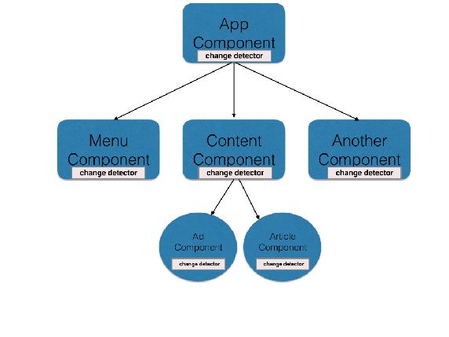
Angular 2 implements web standards like components.
Angular 2 implements web standards like components, and it provides better performance than Angular 1.

Slide 14
Angular 1.x controllers and $scope are gone.
Angular 1.x controllers and $scope are gone. We can say that controllers are replaced with “Components” in Angular 2. Angular 2 is component based. Angular 2 is using zone.js to detect changes.

Slide 15
Way of Bootstrapping Angular Application is changed:
Angular 1.x has 2 ways to bootstrap angular. One using ng-app attribute and other via code.
In Angular 2, say goodbye to ng-app. The only way to bootstrap angular is via code.
The bootstrap function is used and it takes starting component which is also parent component of your angular application.

Slide 16
Ways of Dependency Injection is Changed- syntax changed.
One of the advantages of Angular is Dependency Injection. With Angular 2 DI is there but now there is a different way to inject dependencies. As everything is ‘class’ in Angular, so DI is achieving via constructors.
Note: @Injectable() is added to service class. It is similar to Angular 1.x $inject used for DI.

Slide 17


Slide 18
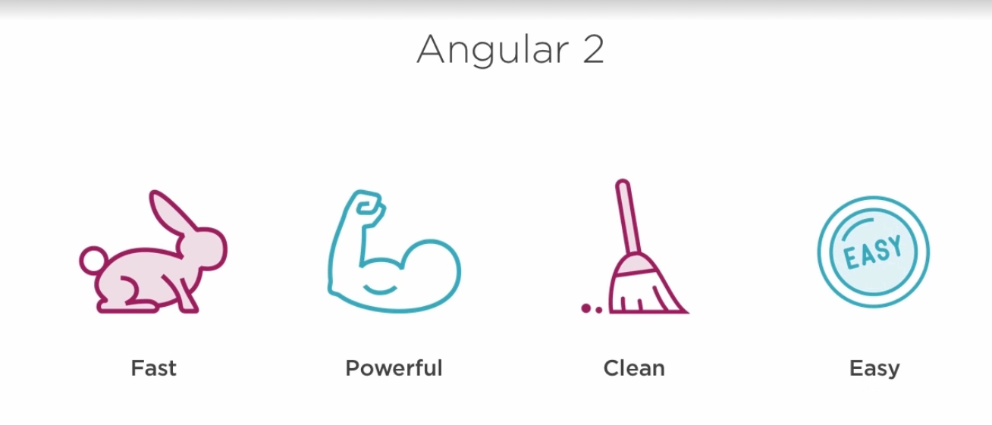

Slide 19
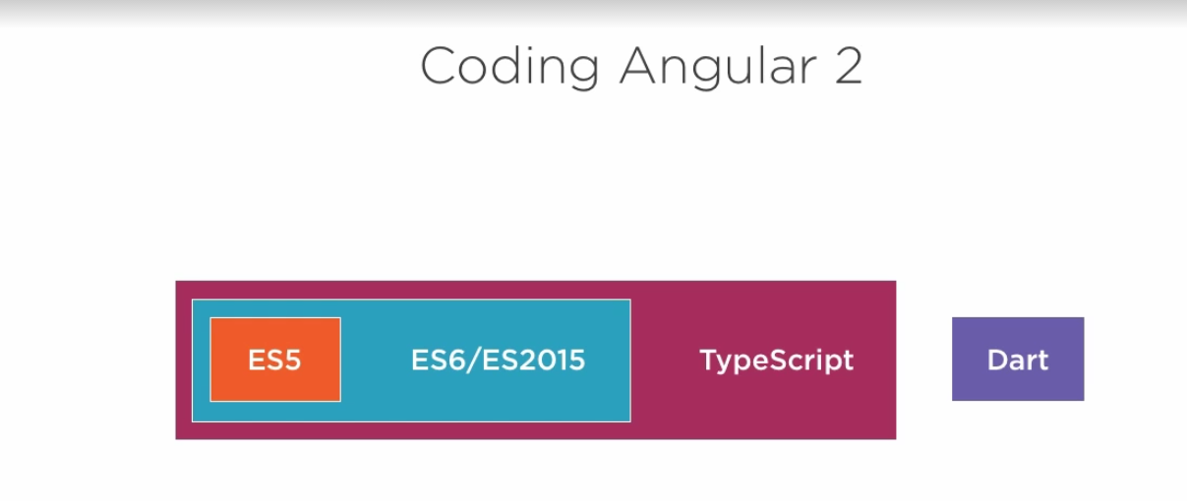

Slide 20
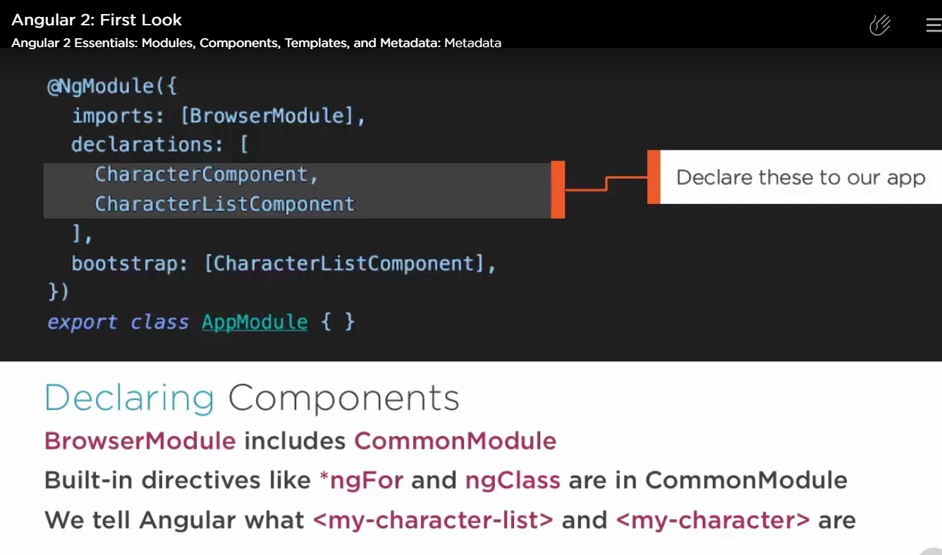

Slide 31

Rahul Srivastava

